Slide 1
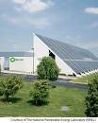
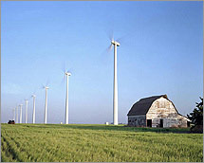
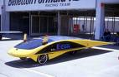
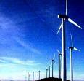
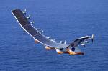
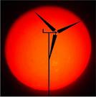
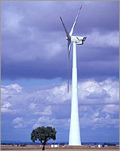
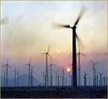
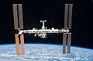
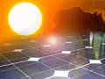
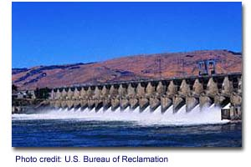
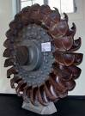
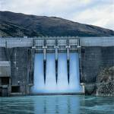
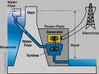
Alternative Sources of Energy
Wind Power
Solar Power
Hydro Power

Slide 2

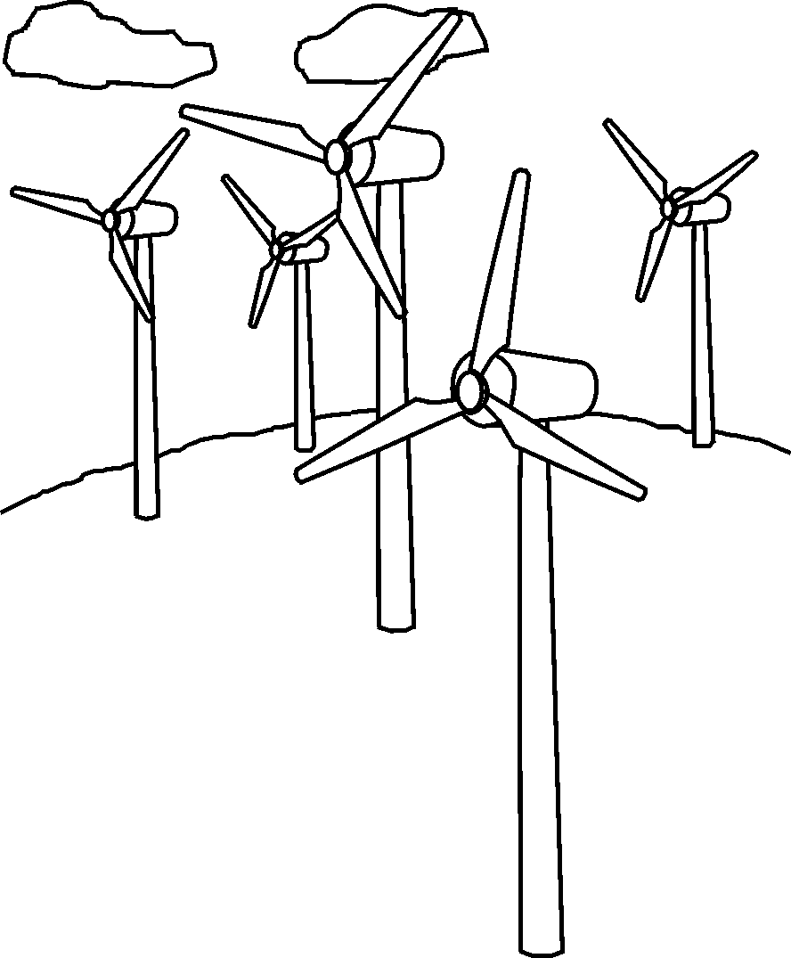
What is Wind?
Wind is a form of Solar Energy
The sun heats the Earth’s surface at varying rates
The air above the warmer areas heats up, becomes less dense and rises
Cooler air from adjacent higher-pressure areas moves to the lower-pressure areas
That movement = wind

Slide 3
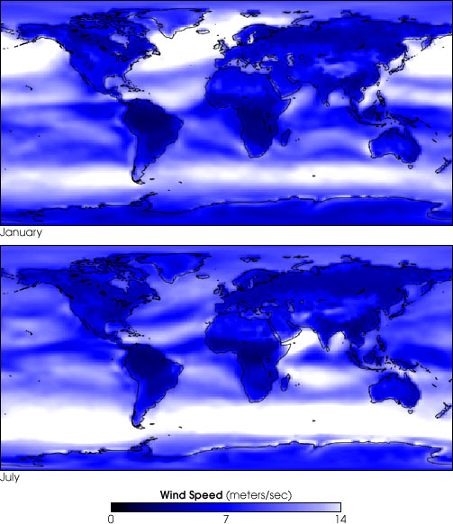
Where in the World is Wind?

Slide 4
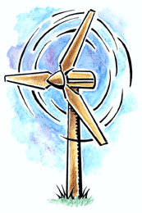
What is Wind Energy?
The process by which the wind is used to generate mechanical energy or electricity
Wind turbines convert the kinetic energy in the wind into mechanical and electrical energy

Slide 5
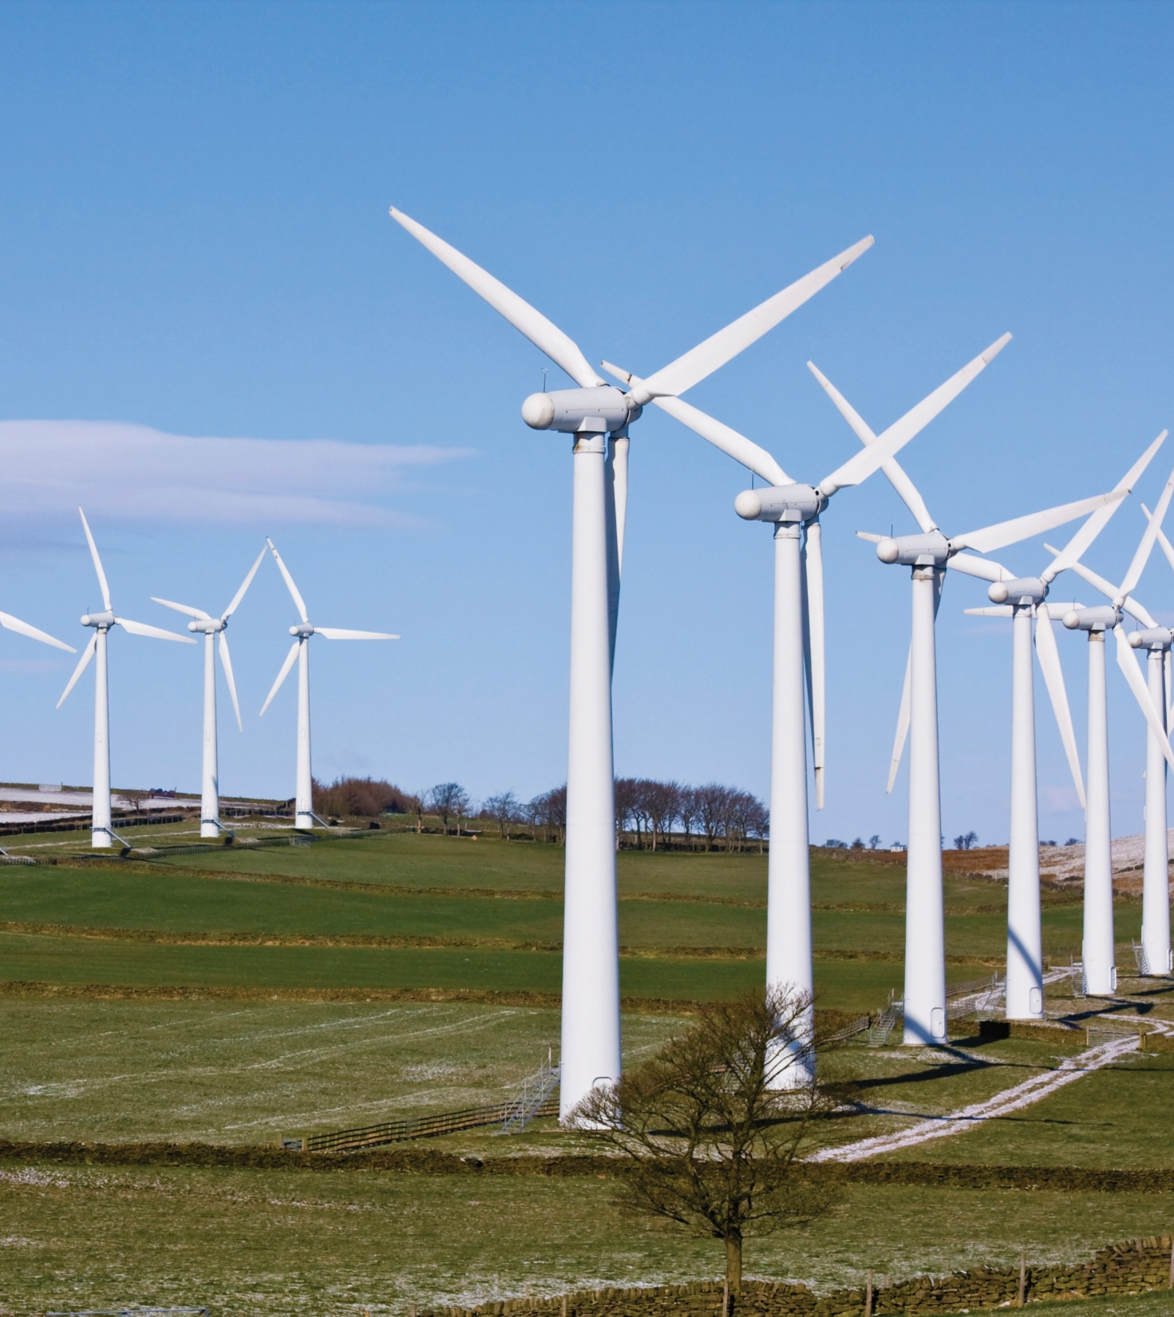
Why Wind Energy?
Clean, zero emissions
NOx, SO₂, CO, CO₂
Air quality, water quality
Climate change
Reduce fossil fuel dependence
Energy independence
Domestic energy—national security
Renewable
No fuel-price volatility
Low cost
Notes:
Wind energy is a renewable source of energy, and is considered renewable because it is derived from the sun and is capable of being replenished on a reasonable time scale.
Although wind is a zero emissions electrical generation option, there are emissions in the construction and development of wind projects—concrete, transportation of components, etc.

Slide 6
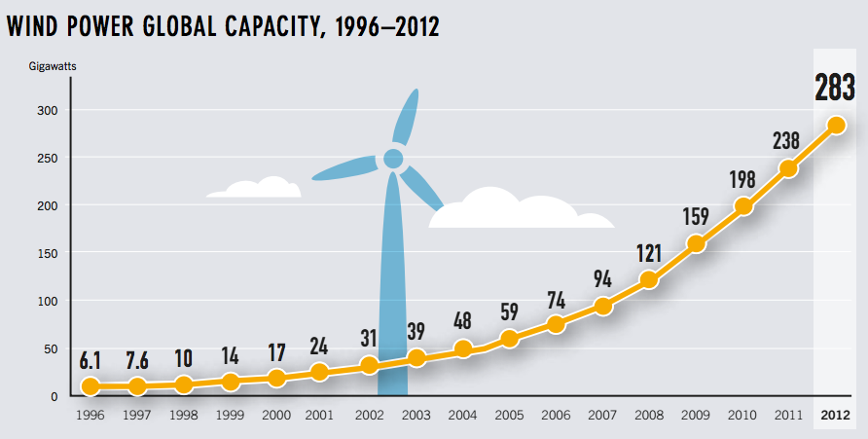

Slide 7
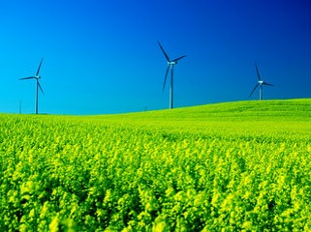
Why Such Growth?
…costs are low!
Increased Turbine Size
R&D Advances
Manufacturing Improvements
1979
40 cents/kWh
2000
4-6 cents/kWh
2004
3-4.5 cents/kWh
2011
Less than 5 cents/kWh
Notes:
The rapid growth in wind power can be attributed to two things–reduction in cost of electricity produced and more interest in renewable technologies. Between 2004 and 2011, an increase in price can be attributed to higher rates of demand than supply of turbines and rising commodity prices including a rise in the price of steel.

Slide 8
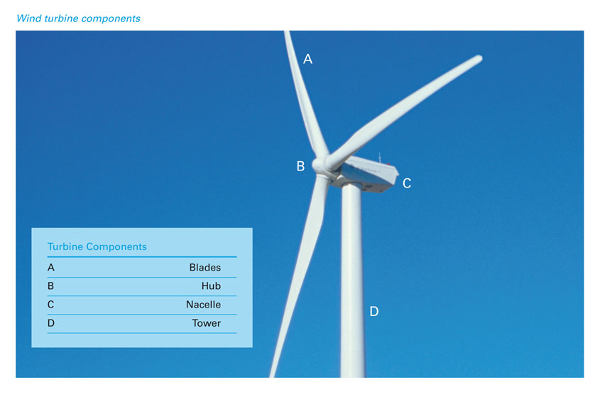
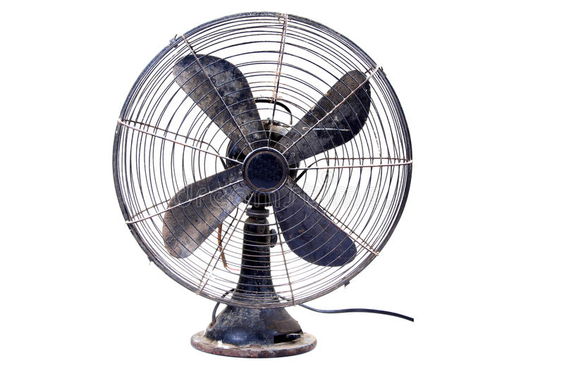
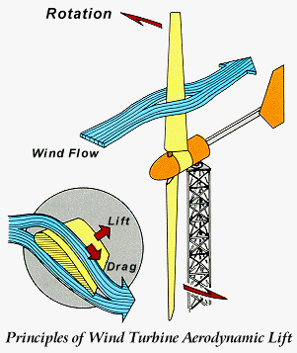
Wind Turbines:
opposite of a fan
KE to Usable Energy
“rotary engine in which the kinetic energy of a moving fluid is converted into mechanical energy by causing a bladed rotor to rotate”
Notes:
Regardless of the size, all turbines have the same parts.
Blades on modern turbines are similar to airplane blades, lifted by the wind.
The hub connects the blades to the shaft and generator.
The nacelle houses the generator.
The tower holds the turbine high above anything that might cause turbulence in the air such as trees and buildings. Towers can be lattice or monopole for large turbines. Most modern day turbines have monopole towers made of steel.

Slide 9
Wind Turbines
turbine blades spin from the wind and make energy, instead of using energy to make wind
Wind rotates the turbine blades
spins a shaft connected to a generator
The spinning of the shaft in the generator makes electricity

Slide 10
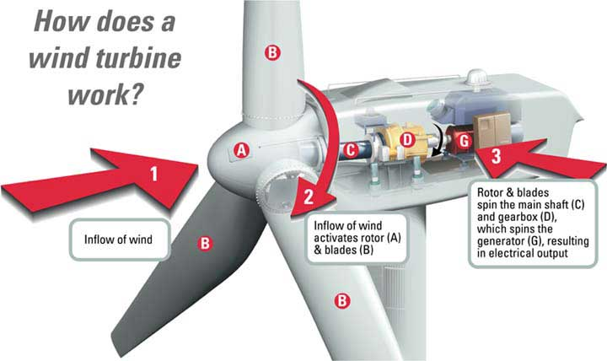
How a Wind Turbine Operates
Notes:
Comparing large turbines to small turbines:
Large turbine blades can be actively pitched by hydraulics and spin at 12-20 RPM—much slower than a small wind turbine.
Large turbines have a driveshaft attached to the gearbox—that step up the rotations from 12-20 RPM to 1600 RPM for the generator.
The generator is what creates electricity, turning coils of wires inside magnets.
Small wind turbines use vanes (typically) to track the wind while large turbines use an anemometer and hydraulics to face the turbine into the wind.
Large turbines are highly computerized and automated, sensing weather conditions and turning themselves off if there is a problem.
Large turbines are often connected by computers to a central control location.

Slide 11
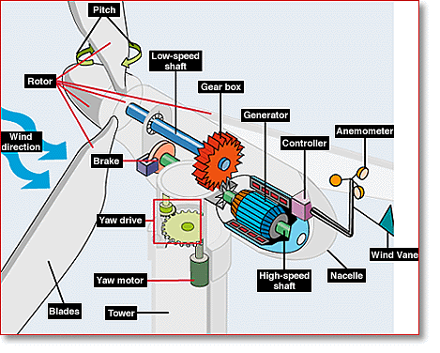
Internal Parts: The “Hub”

Slide 12
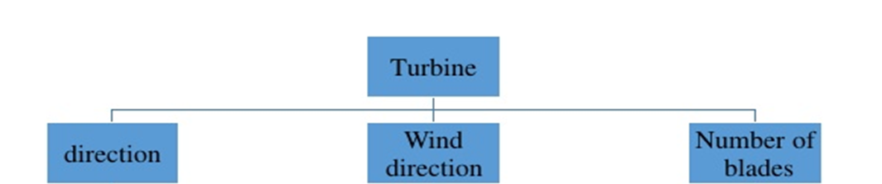
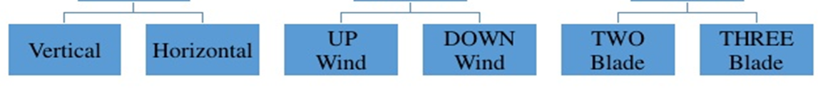
Classification of wind Turbine:

Slide 13
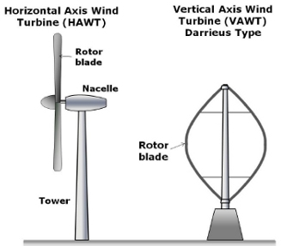
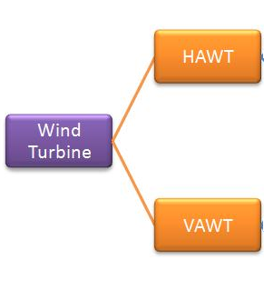
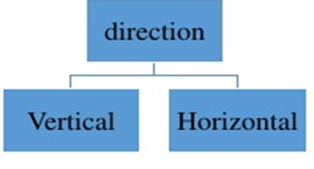

Slide 14
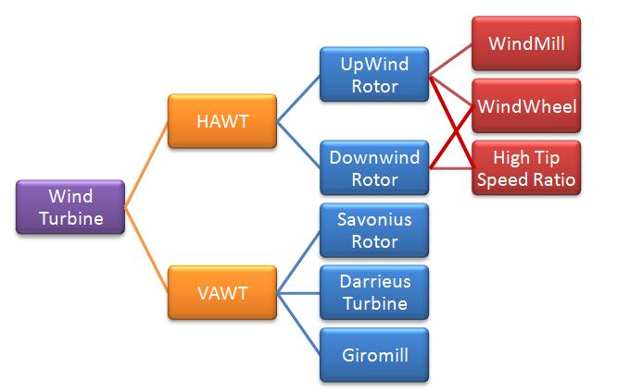

Slide 15
Vertical Axis Advantages
Can place generator on ground
You don’t need a yaw mechanism for wind angle
Disadvantages
Lower wind speeds at ground level
Less efficiency
Requires a “push”
Horizontal Advantages
Higher wind speeds
Great efficiency
Disadvantages
Angle of turbine is relevant
Difficult access to generator for repairs

Slide 16
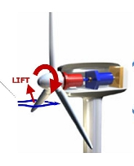
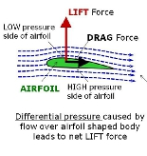
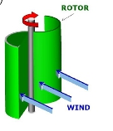
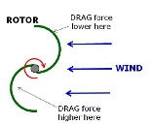
Rotor Type:
Lift type wind Turbine:
Drage type wind Turbine:

Slide 17
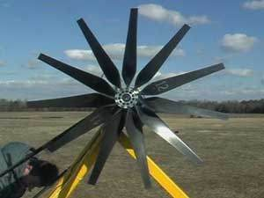
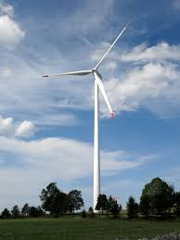
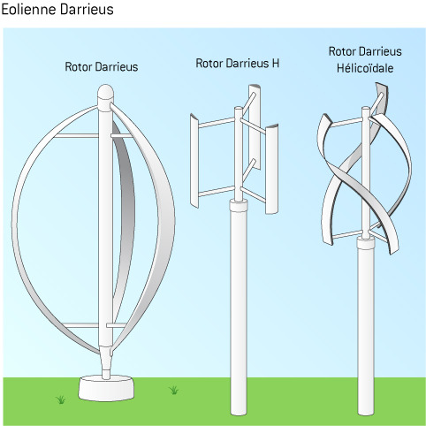
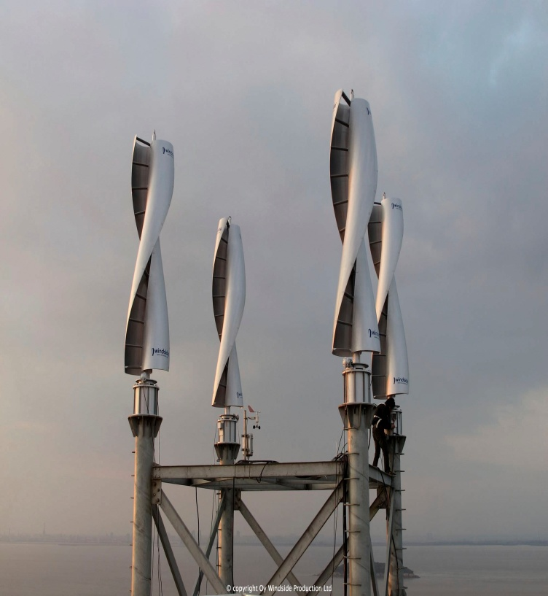
Rotor Type:
Lift type wind Turbine:
Multiblade Rotor:
Propeller Rotor:
Drage type wind Turbine:
Savonius Rotor:
Darrieus Rotor:

Slide 18
Terms used in wind energy:
Stall regulated system
Swept are
Solidity
Drag Force
Lift Force
Nacelle
Yaw Control
Cut-in speed
Rated wind speed
Cut-out speed
Down wind speed
Up wind speed
Wind rose
Wind Van
Airfoil
Angle of attack
Blade
Leading edge
Trailing edge
Chord line
Mean line
Camber
Roter
Hub
Propeller
Tip speed ration
Pitch angle
Pitch controll blades

Slide 19
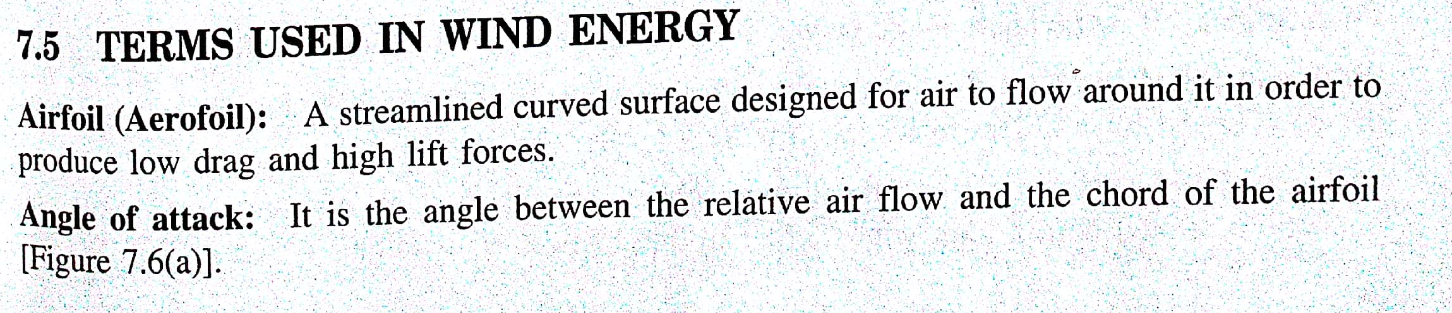

Slide 20
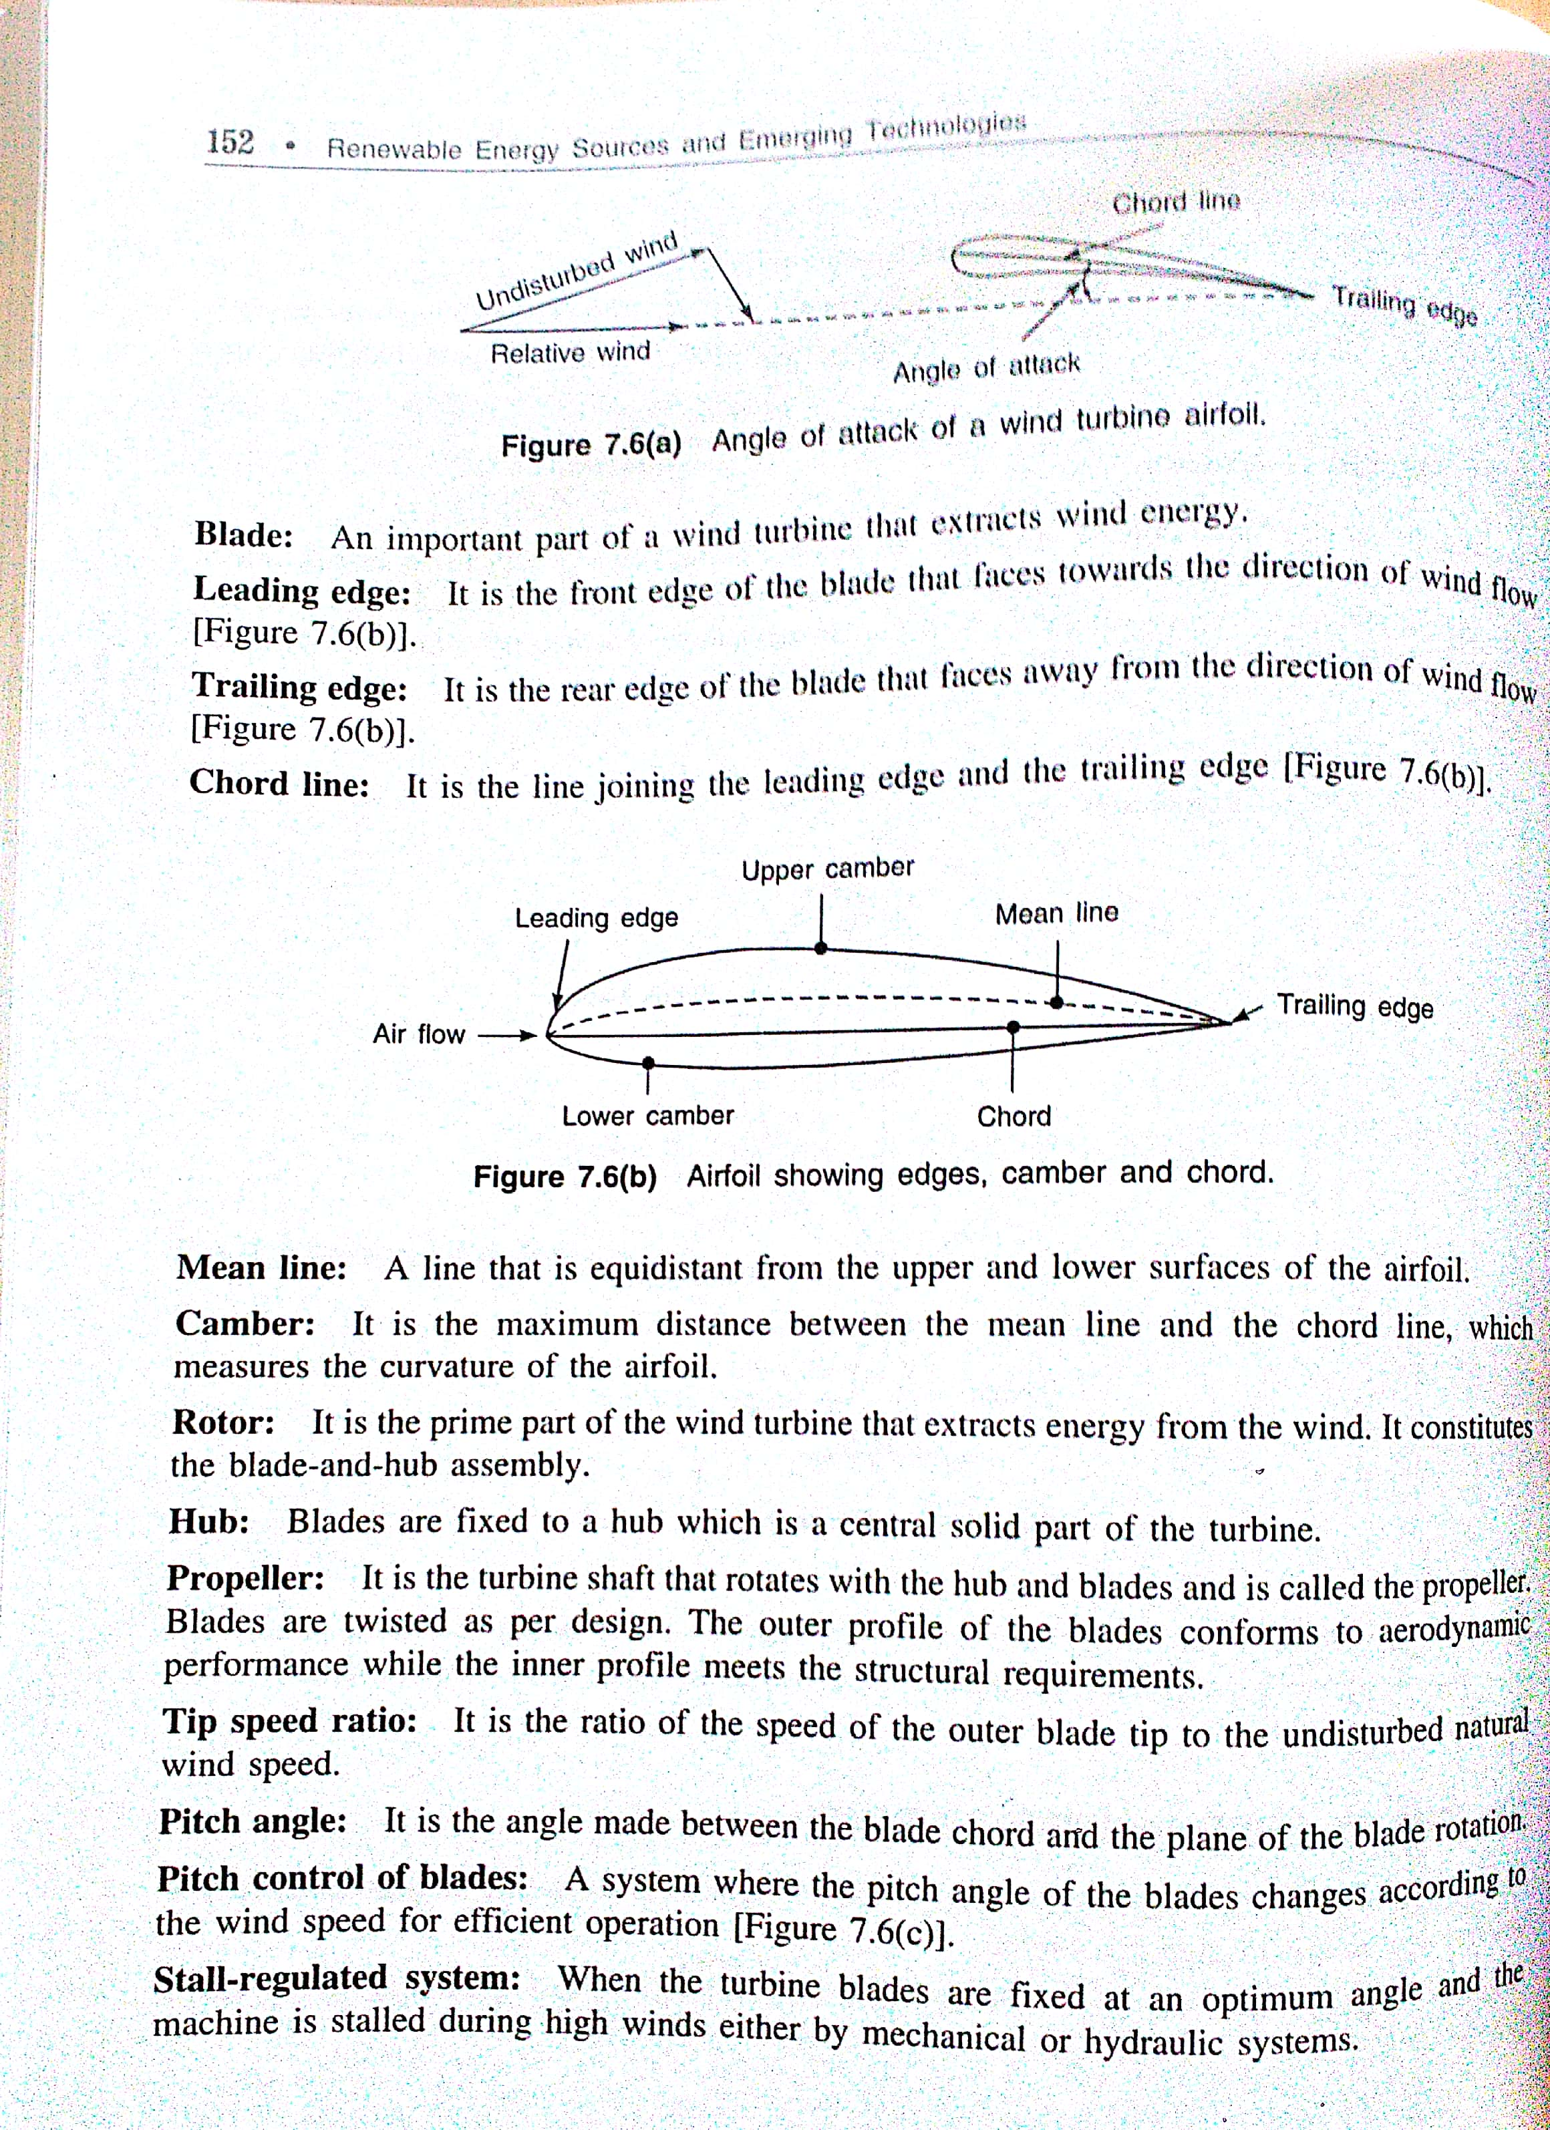
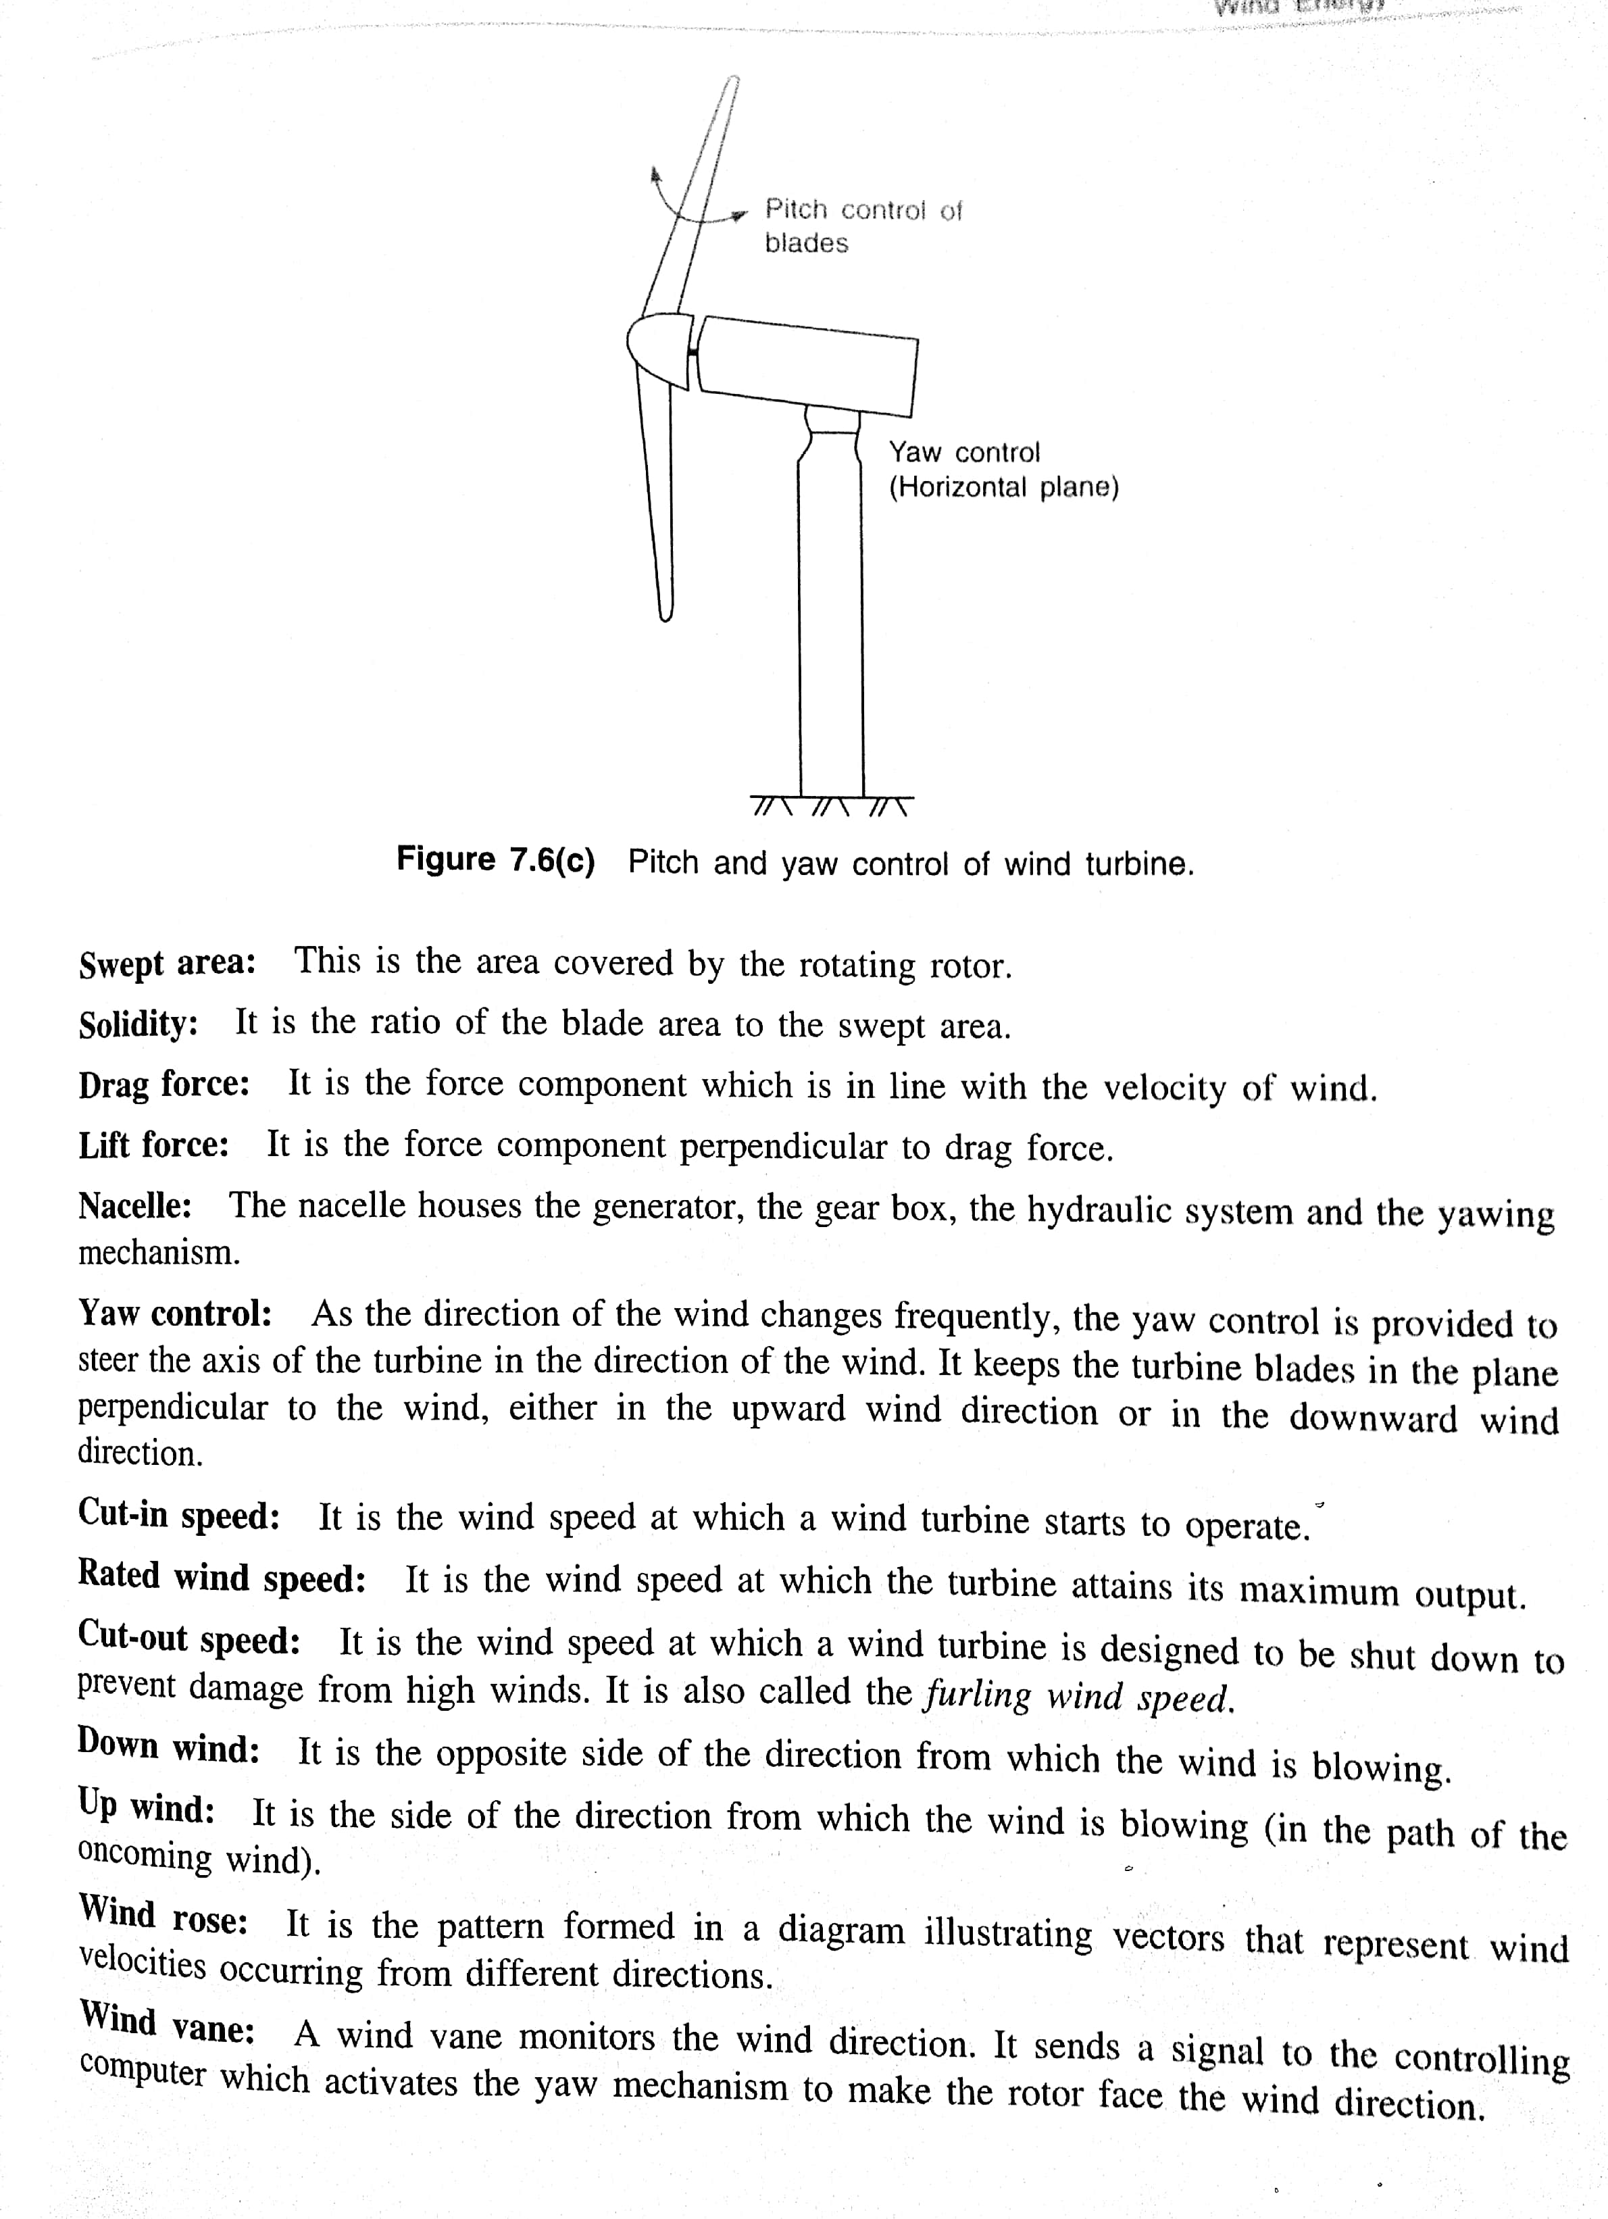

Slide 21
Wind Energy and Power:
Atmospheric pressure differences accelerate and impart kinetic energy into the air
Wind energy conversion machines (WEC) convert wind energy into electrical or mechanical forms
How much power can we extract?

Slide 22
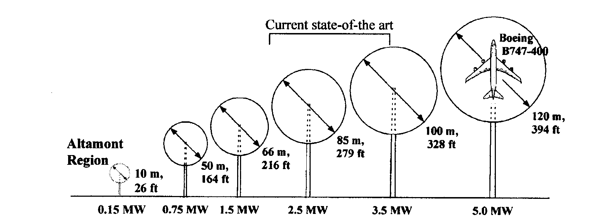
Wind Turbine Size-Power Comparison

Slide 23
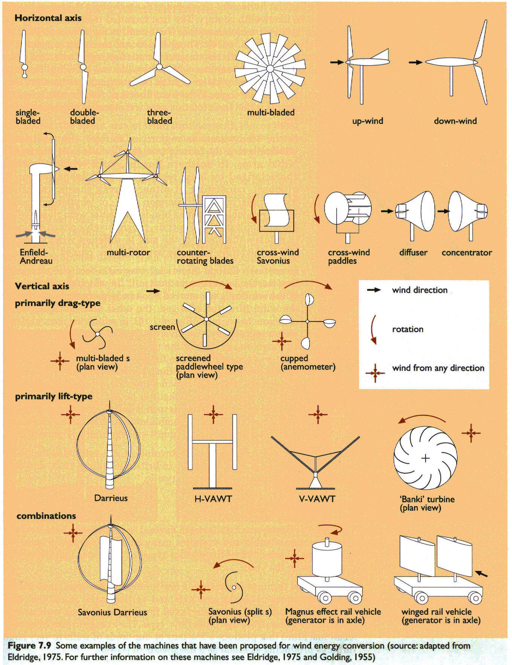
Wind Turbine Configurations
HAWT
VAWT
Boyle, G., Renewable Energy, 2nd ed., Oxford University Press, 2004

Slide 24
Configuration Tradeoffs
Factors
Efficiency
Power produced per unit cost
Directionality
Support configuration
Speed of rotation
Reliability
Cost
Maintainability
Which type is best, HAWT or VAWT?

Slide 25
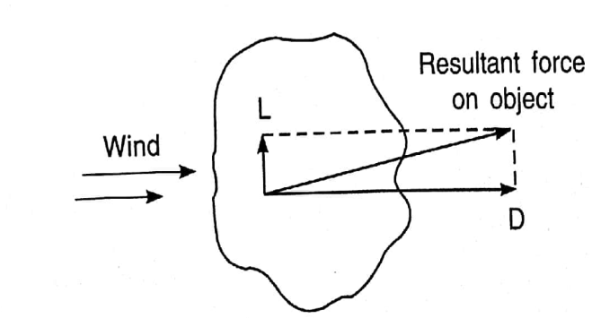
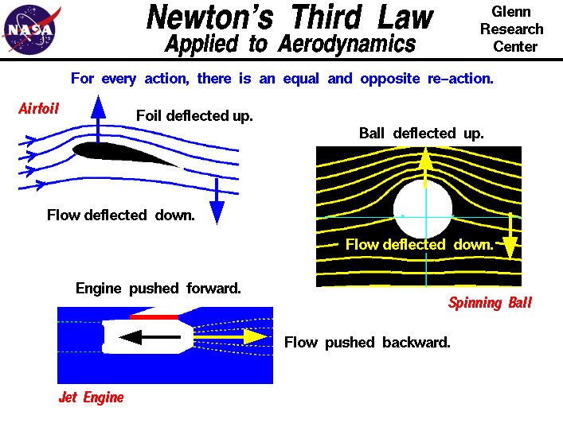
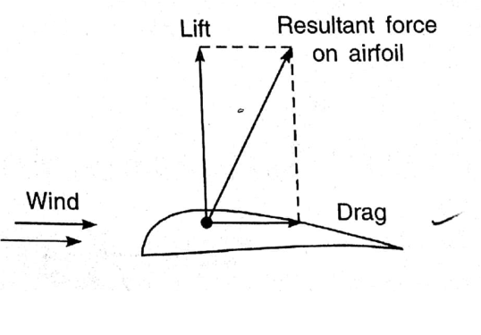
Aerodynamics of Wind Turbine Blades
Forces are transmitted from a moving fluid to an object in the flow stream
Lift = the force component perpendicular to the original flow direction
Drag = the force component in line with the original flow direction
Lift
Drag

Slide 26
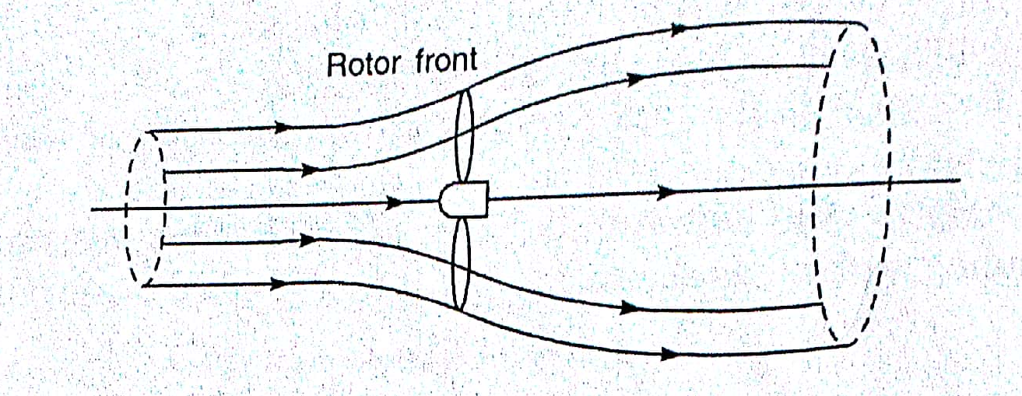
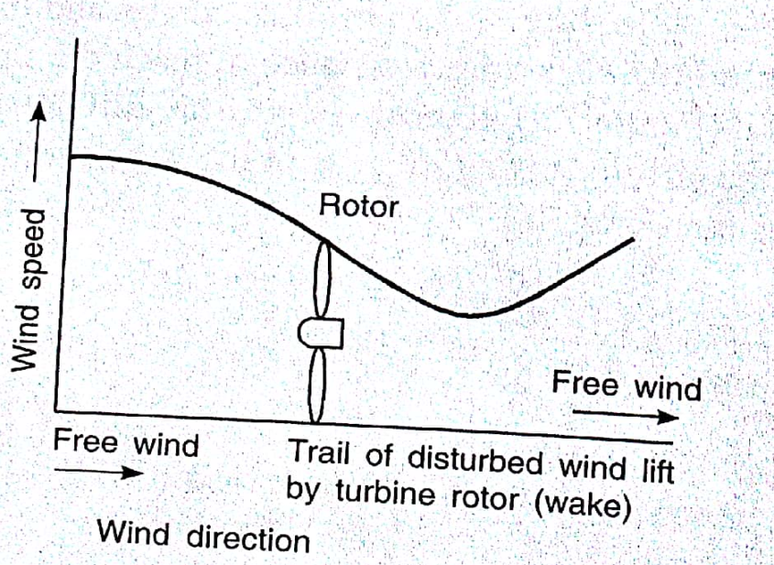
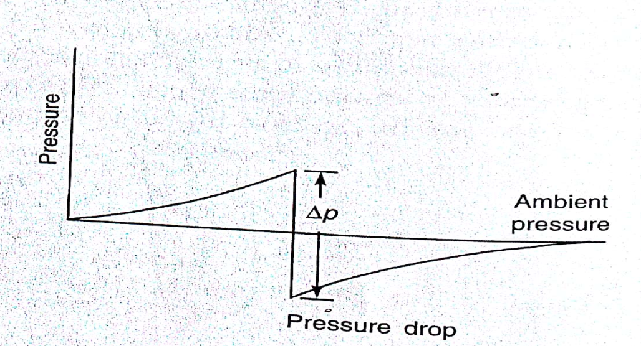
Wind Energy Extraction:

Slide 27


Slide 28







(1)
(2)
Force on rotor :
(3)
Change of momentum per unit time from upstream to down stream wind
Bernoulli Equation:
p + 0.5 ρ V² = constant
Incompressible flows; along a streamline, . .
A_{1,} V₁
A_{2,} V₂
(4)
Internal flows:
Conservation of mass; ρ A V = constant
If ρ is constant, A₁ V₁ = A₂ V₂
(5)

Slide 29







(4)
(6)
(5)
From force equations:
(7)
From 6 & 7
(8)
In wind turbine system, steady flow work is equal to the difference in the KE
of upstream and down stream of turbine for unit mass flow
(9)
Power output P of turbine is rate of work done using mass flow equation:
(10)

Slide 30










(10)
For max output P:
V_{d} = V_{u}/3
V_{d}= V_{u}
(11)
Available efficiency:
Total wind power:

Slide 31







Calculation of air density:
Air density varies directly with air pressure and indirectly proportional to temperature
Notes:
A typical U.S. large-scale horizontal wind turbine stands 80-100 meters (263-328 feet) tall and has three blades that are each 34-55 meters (112-181 feet) long. They weigh 200-400 tons and produce enough electricity to power 500 homes.
The largest turbine currently in production is the Enercon E-126 which as a capacity of 7.58 MW.
The E-126 tower stands 135 meters (443 feet) tall and has a blade diameter of 127 meters (417 feet).
A number of companies are developing 10 MW turbines mostly for use in offshore applications.

Slide 32


Slide 33


P _{max} = 8/27 ρ A V³
P _{max} = 0.593 Pw
or
Power coeff Cp = =.593
Available efficiency
η =0.6x Cp
= 35.5%
Power: depending D² and v³

Slide 34


Power: depending D² and v³
Wind Characteristics:
wind/air motion:
position/location/time/duration dependent over the year
vector quantity
max at exposed hill top/offshore/coastal are
magnitude of horizontal component

Slide 35


Power: depending D² and v³
Energy Estimation:
Power: v³
Cut in speed: V_{c}
Design speed: V_{d}
Cut out speed: V_{f}

Slide 36

A: power density at cut in speed V_{c}
B: power density at Design speed V_{d}
C: power density at Cut out speed V_{f}
Area EFGHJ: annual energy output from wind machine

Slide 37

Wind & Hight…….

Slide 38

Thrust and Torque on Turbine Rotor:

Slide 39
Classes of Wind Power Density at 10 m and 50 m^{(a)}
.
10 m (33 ft)
50 m (164 ft)
Wind Power Class
Wind Power Density (W/m²)
Speed^{(b)} m/s (mph)
Wind Power Density (W/m²)
Speed^{(b)} m/s (mph)
1
<100
<4.4 (9.8)
<200
<5.6 (12.5)
2
100 - 150
4.4 (9.8)/5.1 (11.5)
200 - 300
5.6 (12.5)/6.4 (14.3)
3
150 - 200
5.1 (11.5)/5.6 (12.5)
300 - 400
6.4 (14.3)/7.0 (15.7)
4
200 - 250
5.6 (12.5)/6.0 (13.4)
400 - 500
7.0 (15.7)/7.5 (16.8)
5
250 - 300
6.0 (13.4)/6.4 (14.3)
500 - 600
7.5 (16.8)/8.0 (17.9)
6
300 - 400
6.4 (14.3)/7.0 (15.7)
600 - 800
8.0 (17.9)/8.8 (19.7)
7
>400
>7.0 (15.7)
>800
>8.8 (19.7)

